Slide 1
Docker - Manipulate container
Hung.Tran

Slide 2
CONTENT
Docker run in detail
Overriding default commands
List of running containers
Docker lifecycle
Restarting stopped containers
Removing stopped containers
Using Docker Client
What is Docker Container
How’s docker running on your computer

Slide 3
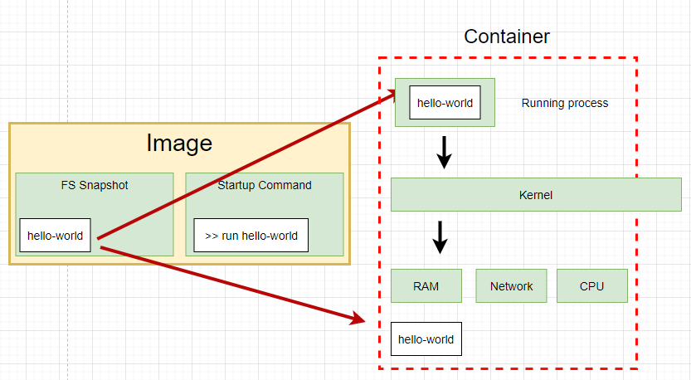
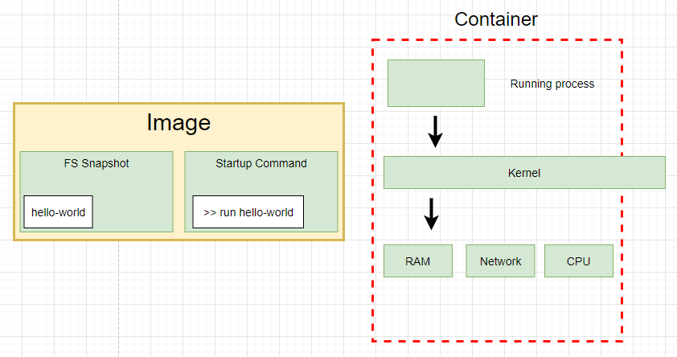
Docker run in detail
docker run hello-world

Slide 4
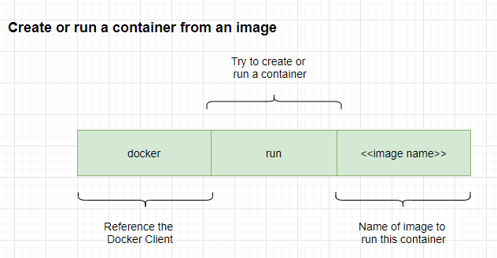
Docker run in detail

Slide 5
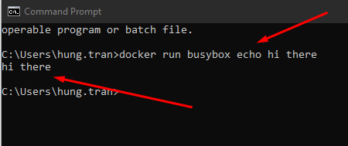
Overriding default commands
Run a command and show message
>> docker run busybox echo hi there
Notes:
we choose busybox becuase it has echo or ls command in its container.
hello-world is a single file container.

Slide 6
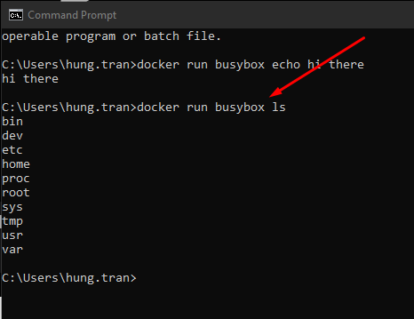
Overriding default commands
Show list of foder of the container
>> docker run busybox ls

Slide 7
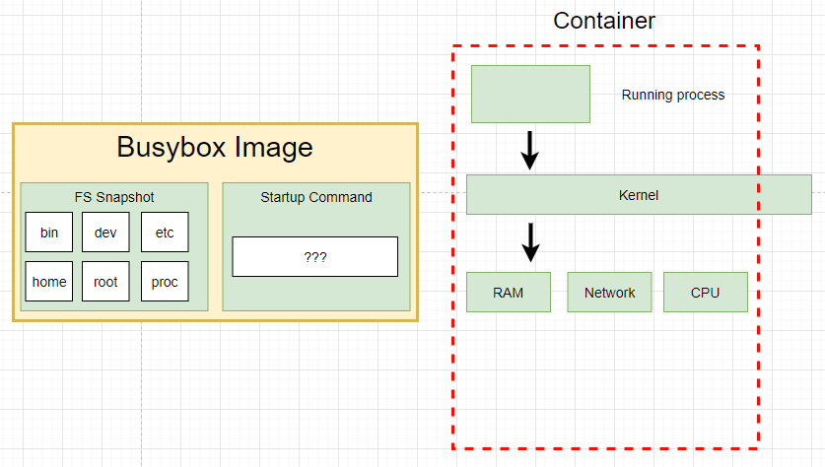
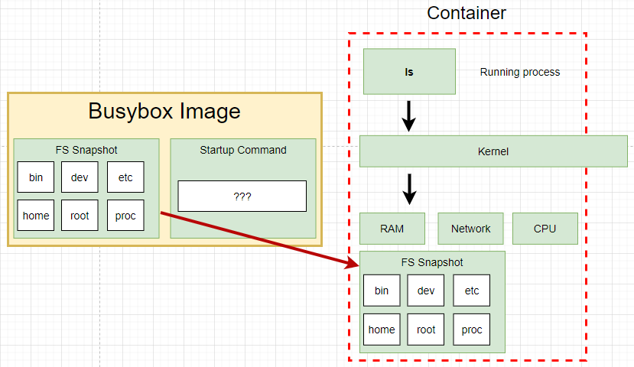
Overriding default commands
Show list of foder of the container
>> docker run busybox ls

Slide 8

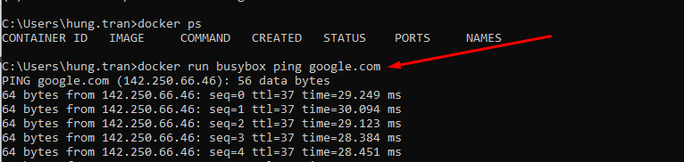
List of running container
Show list of running container
>> docker ps

Slide 9
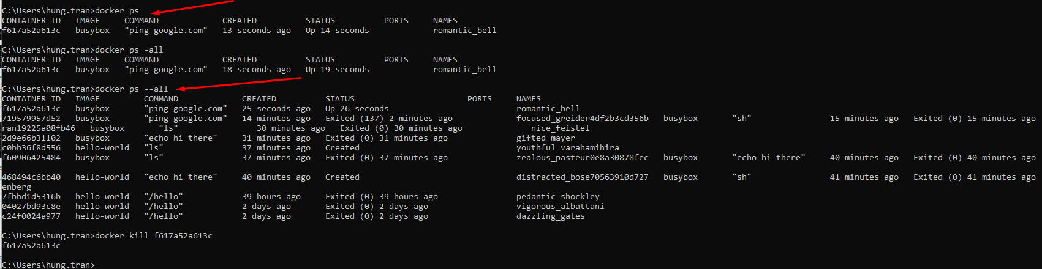
List of running container
Show list of running container
>> docker ps
Show all containers that have ever been created on our machine
>> docker ps --all

Slide 10
Docker lifecycle
docker run hello-world

Slide 11
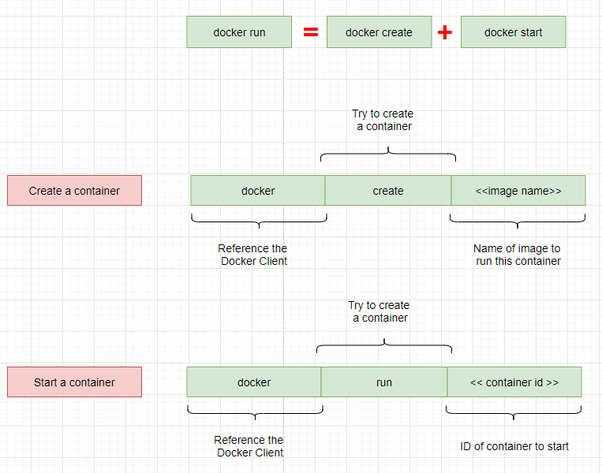
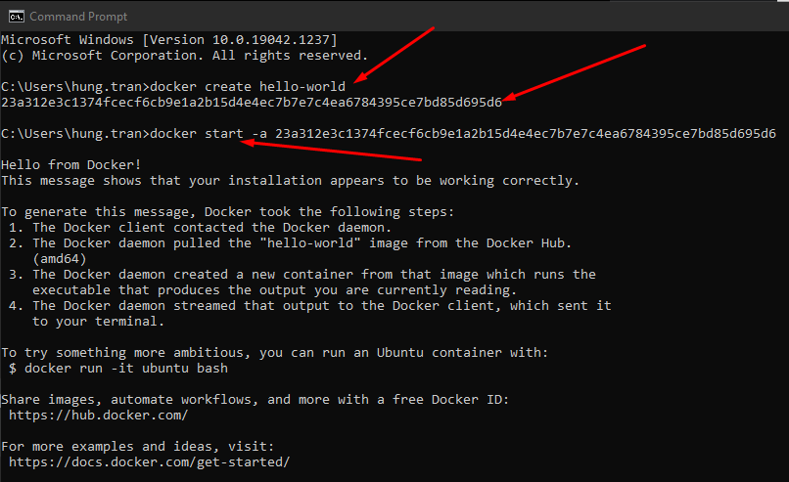
Docker lifecycle
docker run hello-world
Notes:
docker start -a hello-world
-a is a option, let the docker show the output coming from it and print it out at the terminal
docker run
=> is going to show you all the logs or all the information coming out of the container by default

Slide 12
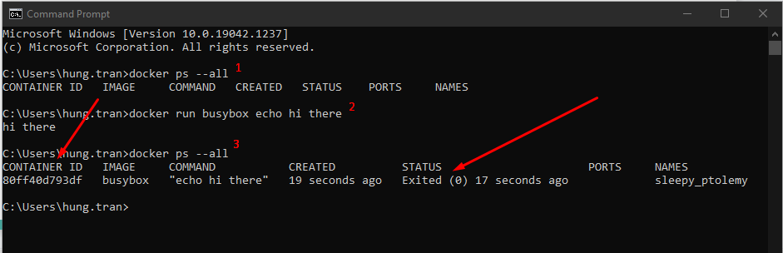
Starting stopped container
Status = exited, mean it’s instance till exist in the cache, so we can recall it by using its ID
Notes:
check all container are running
>> docker ps --all
run busybox container
>> docker run busybox echo hi there
check all containers are running
>> docker ps --all
Restart a stopped container by using its ID
>> docker start -a ID
If you try to change the default command, it still show error
>> docker start -a ID echo hello

Slide 13
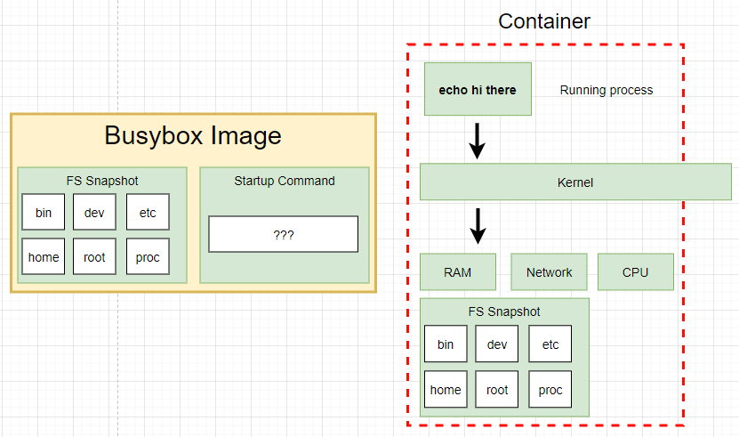
Starting stopped container
Notes:
check all container are running
>> docker ps --all
run busybox container
>> docker run busybox echo hi there
check all containers are running
>> docker ps --all
Restart a stopped container by using its ID
>> docker start -a ID
=> When run the container second time, The primary command will start automatically
If you try to change the default command, it still show error
>> docker start -a ID echo hello
=> It will show the error because the current primary command here cannot override

Slide 14
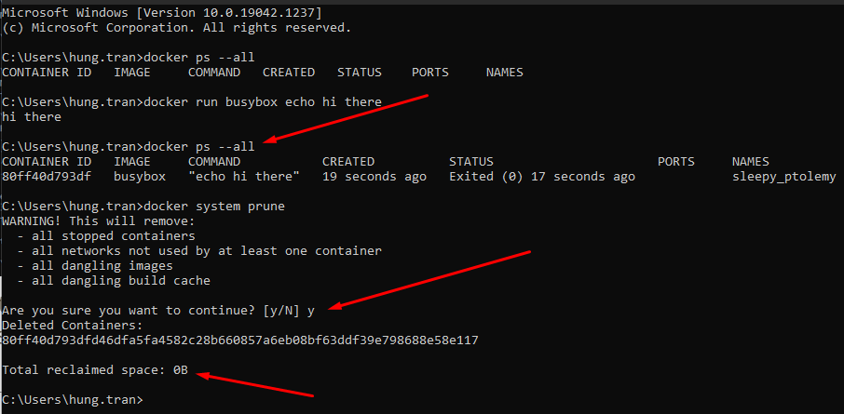
Removing stopped container
docker system prune
=> remove all stopped containers, cache and redownload images from docker hub

Slide 15
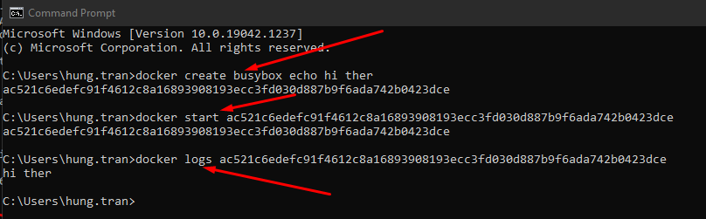
Retrieving log Outputs
docker logs <<container_id>>
=> With this command, we don’t re-run the container again. It only emitted what it works

Slide 16
Retrieving log Outputs
docker logs <<container_id>>
=> With this command, we don’t re-run the container again. It only emitted what it works

Slide 17
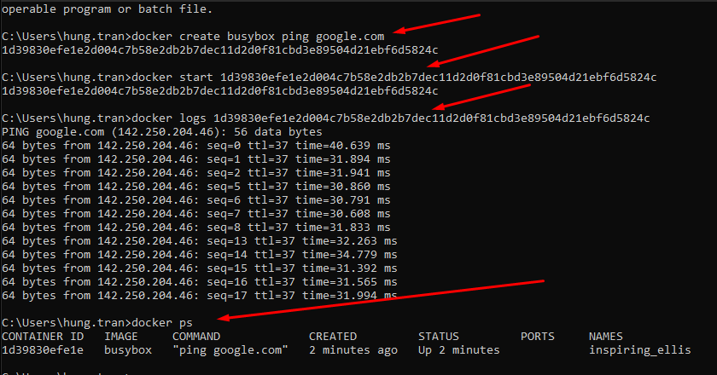
Stopping container
First, create, run and view log of the container

Slide 18
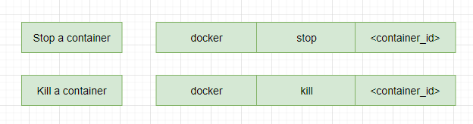
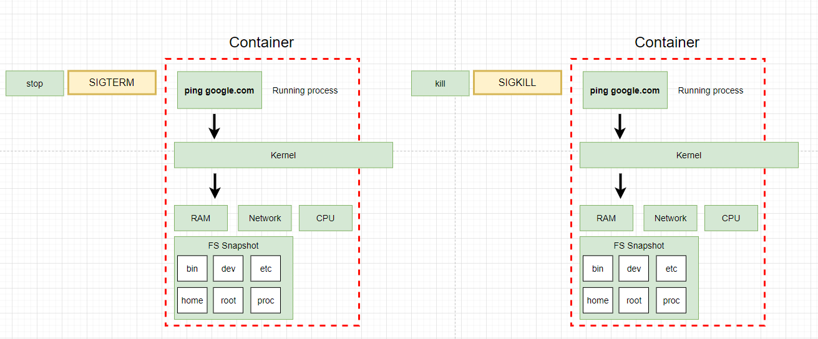
Stopping container
Notes:
stop and kill are used to stop and kill a container. But it has a different
when use stop command, a hardware signal sent to the primary process inside the container (SIGTERM mean terminate signal) to let the container know to shutdown now with a little bit time to clean up the conainer (save files, or emit some messages,...)
- if the container does not stop in 10 seconds, it wil call kill command.
kill command: to sent a signal to the primary container to kill the container immediatelly.

Slide 19
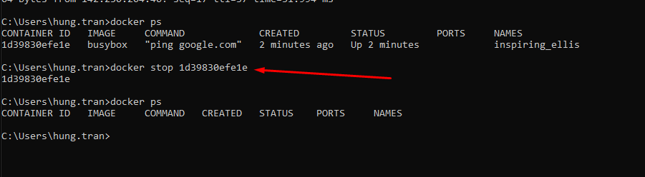
Stopping container
>> docker stop <container_id>
Waiting for over 10 seconds to stop the container

Slide 20
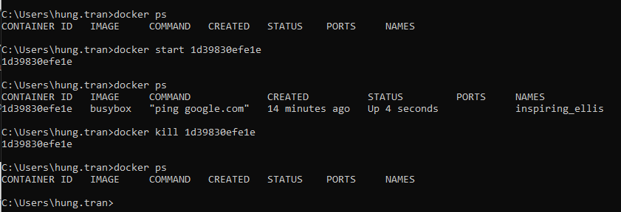
Stopping container
Start container again and use kill command
>> docker kill <container_id>
Stop the container immediately

Slide 22
What is Docker
Docker Container: is a standard unit of software that packages up code and all its dependencies so the application runs quickly and reliably from one computing environment to another.
Docker Container Image: is a lightweight, standalone, executable package of software that includes everything need to run an application: code, runtime, system tools, system libraries and settings
Images become Containers at runtime when they run on Docker engine. Container is an instance of image to run a specific application.
Docker Container are everywhere, It can run on Linux, Windows, Data Center, Cloud, Serverless...

Slide 23
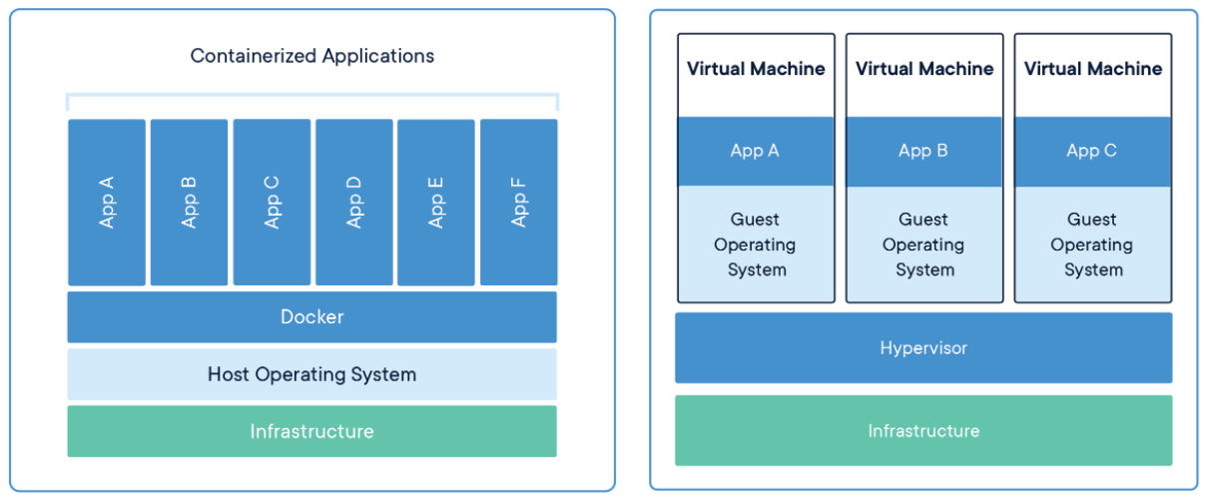
Containers vs Virtual Machines
Both of them are similar resource isolation and allocation benefits
The Container virtualizes the operating system instead of hardware. Containers are more portable, lightweight and efficient

Slide 24
Why is Docker
Container use shared operationg systems. This means they are much more efficient then HyperVisor in the system resource terms
Docker allows developer easily pack, ship, and run any applications as a lightweight, portable, which can run virtually anywhere
Container enables developers to isolate code into a single container. It makes easier to modify and update the program
Docker supports CI/CD so we can deploy an application quickly
Docker Containers are easy to deploy in a cloud

Slide 25
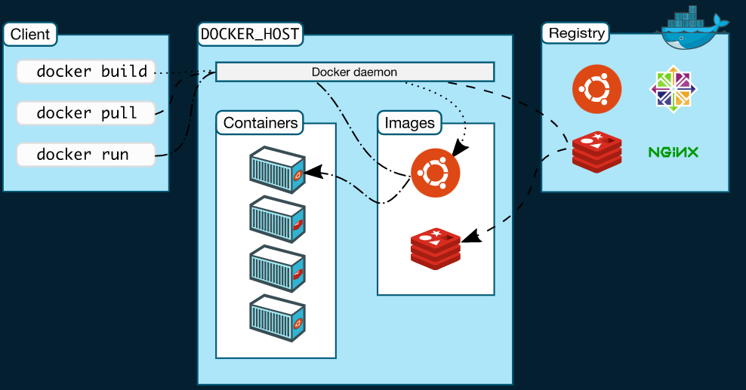
Docker Architechture
Uses a client-server architechture
Docker Client talks to Docker Daemon, which does the heavy lifting fo building, running, and distributing your docker containers.
Docker client and Deamon can run on the same system or you can connect a docker client to a remote docker deamon.
Docker client and daemon communicate using a REST API, over UNIX sockets or a network interface
Another docker client is Docker Compose, that lets you work with applications consisting of a set of containers

Slide 26
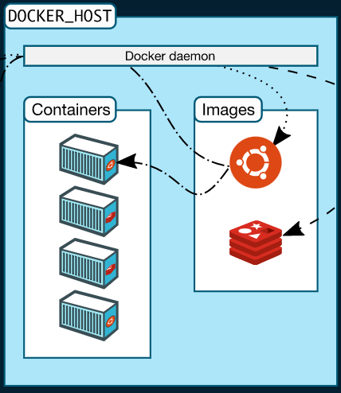
Docker Architechture - Docker daemon
Docker Daemon listens for Docker APIs requests and manages Docker objects such as images, containers, networks and volumes
A docker daemon can also communicate with other daemons to manage docker services

Slide 27
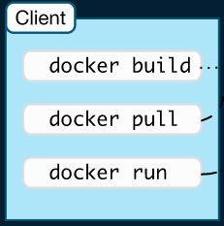
Docker Architechture - Docker client
Docker client is the primary way that many docker users interact with Docker by using a command
The docker command use the Docker API
The docker client can communicate with other than one daemon

Slide 28
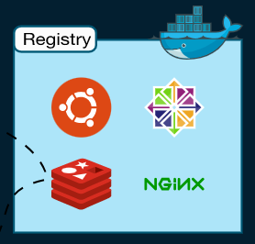
Docker Architechture - Registry
A Docker registry stores Docker Images
Docker Hub is a public registry that anyone can use
Docker is configured to look for images on Docker Hub by default

Slide 29
Docker Installation
Windows 10 Pro and some Windows 10 Home users will be able to install Docker desktop if their computer supports the Windows Subsystem for Linux (WSL2)
After completely installed WSL2, Then install Docker Desktop
If you are Windows 10, You can download Docker Toolbox

Slide 30
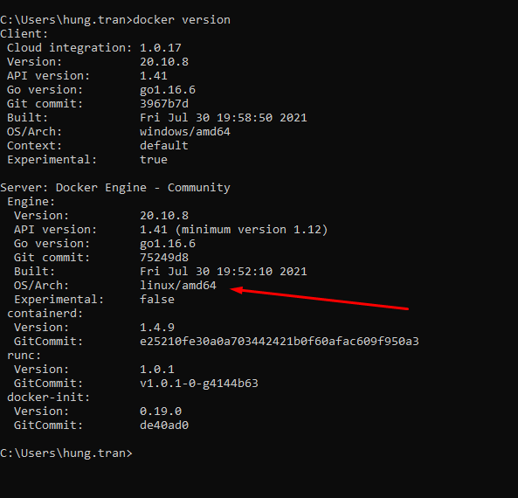
Using Docker Client - docker version
“docker version” command
Check the docker version settup on the local machine

Slide 31
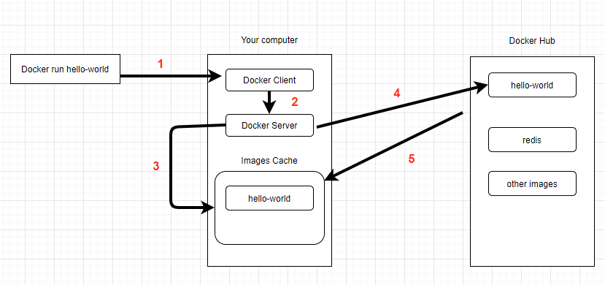
Using Docker Client - docker run hello-world
“docker version” command
Check the docker version settup on the local machine
Notes:
docker run hello-world
That mean we want to starts up a new container with the name hello-world
Docker Client communicate to Docker Server
If the Docker Server found a hello-world container from Images Cache, It will execute it.
If not, It will call to Docker Hub to find hello-world image.
If exists, that image will be downloaded to Images Cache on local machine and run it.

Slide 32
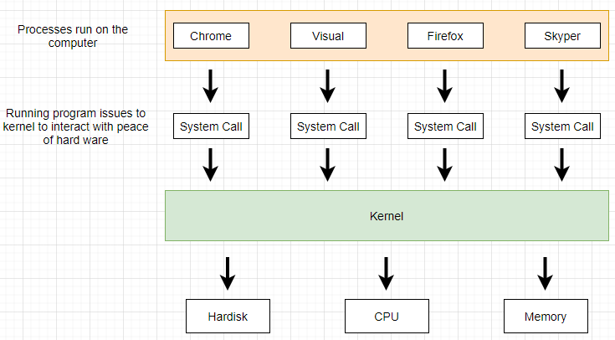
Docker containers
How operating system run in a local

Slide 33
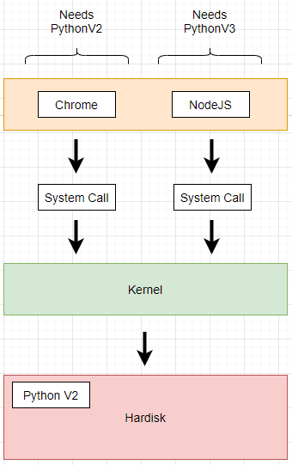
Docker containers
How operating system run in a local
The difference versions on the system

Slide 34
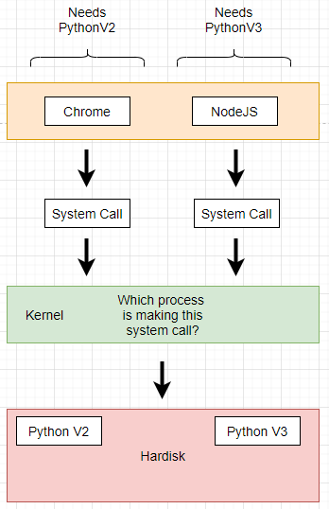
Docker containers
How operating system run in a local
The difference versions on the system
Name spacing technique

Slide 35
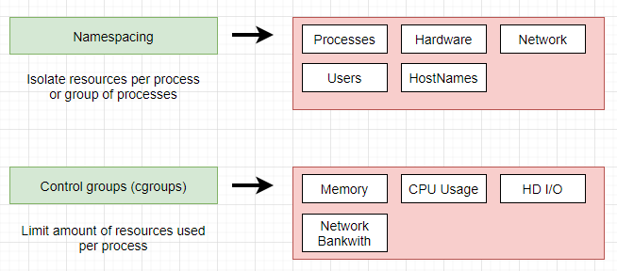
Docker containers
Name spacing technique
It’s not only use for Hardware, It can be also use for software.
Name spacing and Control groups used to isolate and single process and limit the amount of resources it can be used of.

Slide 36
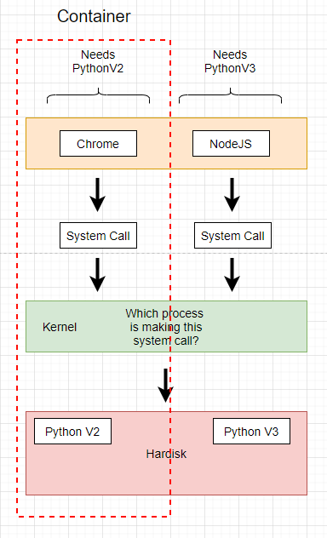
Docker containers
Name spacing technique
It’s not only use for Hardware, It can be also use for software.
Name spacing and Control groups used to isolate and single process and limit the amount of resources it can be used of.

Slide 37
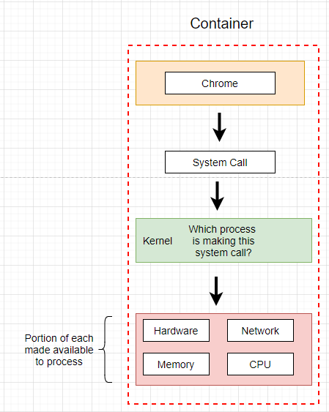
Docker containers
Name spacing technique
It’s not only use for Hardware, It can be also use for software.
Name spacing and Control groups used to isolate and single process and limit the amount of resources it can be used of.

Slide 38
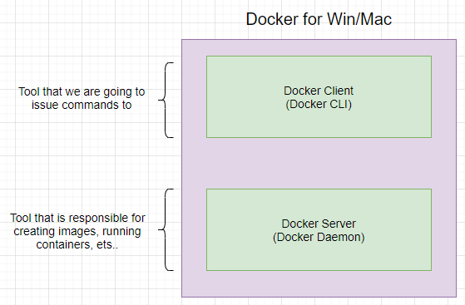
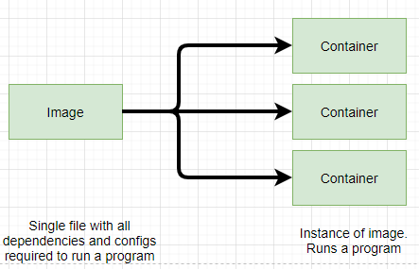
Docker containers
The relationship between image and container and how it work.

Slide 39
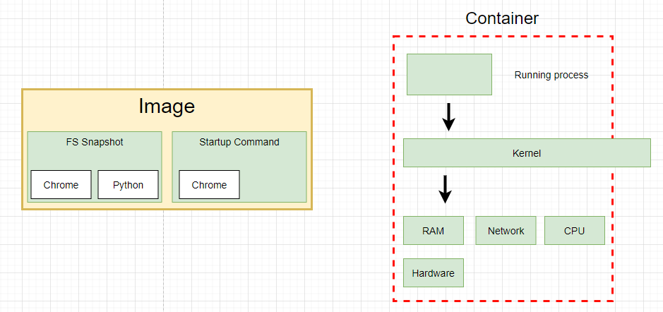
Docker containers
The relationship between image and container and how it work.

Slide 40
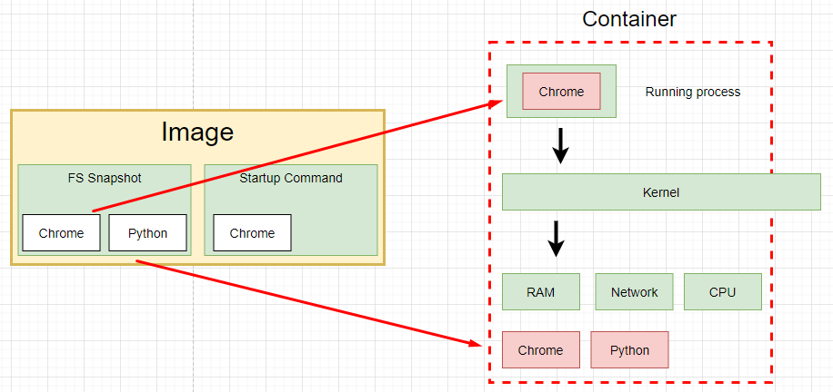
Docker containers
The relationship between image and container and how it work.

Slide 41
How’s Docker running on your computer
Name spacing and Control groups is not on Windows or Mac, It’s belong to Linux

Slide 42
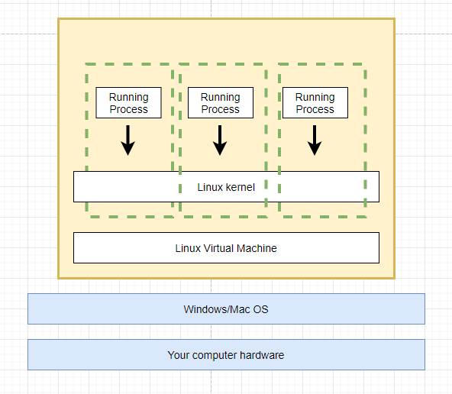
How’s Docker running on your computer
Name spacing and Control groups is not on Windows or Mac, It’s belong to Linux
Linux Virtual Machine is host the docker and container to run

Slide 43
THANKS FOR LISTENING

